Slide 1
Writing a DEP Cybersecurity proposal Tips & Tricks Daniela Bularda Programme Officer
#DigitalEU
#ECCC

Slide 2
Overview
Horizon Europe vs. Digital Europe (Cyber) calls
DEP Cybersecurity
General comments
Criterion 1. RELEVANCE
Criterion 2. IMPLEMENTATION
Criterion 3. IMPACT
Projects at tie

Slide 3
Horizon vs. Digital Europe Cyber calls (non exhaustive list)
Proposal Item | Horizon | DEP
Objective | Research / Innovation | Uptake and Deployment
Main Type of action (funding rate) | RIA (100%) IA (70% / 100%) CSA (100%) | Simple (50%) SME support action (50%/75%) CSA (100%) FSTP (up to 100%)
Pre-financing rate | variable | Usually 80%
Consortium composition | Minim 3 beneficiaries from 3 eligible countries | Mono-beneficiaries allowed
Geographic coverage |  | Security restrictions apply
Evaluation criteria | Excellence / Impact / Quality and efficiency of Implementation | Relevance / Implementation / Impact
Exploitation plan | Yes (IA action) | Yes
3

Slide 4
DEP Cybersecurity - General
Admissible Eligible Original
Check the specific requirements of the call and of the topic
Subject in scope of the Call &Topic
Eligibility of participants (country, type of beneficiary)
Security restrictions (Article 12(5) / 12(6))
Ownership Control Declaration – mandatory;
Country restrictions for subcontracting;
Country restrictions for eligible costs
IPR restrictions
guidance-participation-in-dep-he-edf-cef-dig-restricted-calls_dep-he-edf-cef-dig_en.pdf (europa.eu)
Page limit for part B (70 pages except 50 pages for CSA)
Costs of equipment (depreciation, full cost)
Mandatory requirements for deliverables (ex. communication, dissemination & exploitation – month 6)
Annexes
Do not repeat ad-litteram what is contained in the Call document. Tell your story!
4

Slide 5
Criterion 1. RELEVANCE
Aligned Clear Explained References
Aspects to be taken into account (Items 3 and 4 may not be applicable to all topics see call document):
1. Alignment with the objectives and activities as described in the Call document:
Proposal in line with the call objectives
Proposal’s objectives - clearly defined, justified/demonstrated, aligned with the objectives of the specific topic, with relevant measurable KPIs and target values
2. Contribution to long-term policy objectives, relevant policies and strategies, and synergies with activities at European and national level:
Sufficiently explained and substantiated
Provide clear references to specific initiatives in terms of synergies and don’t stay general
3. Extent to which the project would reinforce and secure the digital technology supply chain in the EU
Sufficiently described
Not checked for all topics
4. Extent to which the project can overcome financial obstacles such as the lack of market finance
Not checked for all topics
5

Slide 6
Criterion 2. IMPLEMENTATION (1/2)
Maturity Added-value State-of-the-art Experience
Aspects to be taken into account:
1 - Maturity of the project
Ensure the right maturity of the proposal with respect to the requirements of the call; maturity can touch upon tools, technology, and services, the experience of partners, standards, etc.
Provide details on the involvement of the beneficiaries in the actions, the advancement compared to the current state of the art, and the topics to be addressed
3 - Capacity of the applicants, and when applicable the consortium as a whole, to carry out the proposed work
Description of the consortium participants
Sufficient information on the background and specific expertise of team members
Adequate experience to be sufficiently demonstrated (eg. List of previous projects relevant to the topic)
By the time of the submission, all entities participating in a proposal should be fully operational
6

Slide 7
Criterion 2. IMPLEMENTATION (2/2)
Logic Interlinked Balanced Controllable Measurable Complete
2 - Soundness of the implementation plan and efficient use of resources
Implementation plan – clearly define the expected scope of the work and its connection to the objectives
Work plan – provide sufficient explanation about
the rationale of each WP,
the work to be performed within each WP,
the connection between the different WPs,
how the activities outlined in the WPs will contribute to achieving the proposal's goal
Tasks
if addressing testing and deployment – provide info on where deployment will take place
For proposals including FSTP activities, they should better define a concrete and feasible timeline.
KPIs – relevant, well defined (including the baseline, connection to the objectives), including a progress evaluation methodology and quality assurance; best KPIs are quantitative and measurable.
Milestones - scheduled over the duration of the project (and not at the end), with enough time for evaluation and corrective measures; avoid setting too many / too specific.
Deliverables – provide detailed descriptions and always pay attention to potential requirements in the Call document
Use of resources – realistic and detailed allocation per WP per partner, both in terms of workload but also of competencies required
Make sure the Gantt chart provides a proper and logical sequencing of activities.
Risks – describe impact and likelihood; provide clear mitigation strategies
7

Slide 8
Criterion 3. IMPACT
Scale Impact Audience Impact
Aspects to be taken into account:
1 - Extent to which the project will achieve the expected outcomes and deliverables referred to in the call for proposals and, where relevant, the plans to disseminate and communicate project achievements
elaborate clearly the scale and significance, make clear how the project intends to improve with respect to current baselines.
KPIs well defined (clear baseline, aligned to the project goals, ambitious)
target audience, key messages, communication channels - well identified and defined; tailored to identified wider audience; credible and ambitious dissemination strategy
2 - Extent to which the project will strengthen competitiveness and bring important benefits for society
provide concrete examples and sufficient details
!!!!!
IMPACT criterion will be considered in case of ties after RELEVANCE
8

Slide 9
Projects at tie
The priority order will be given by (in this succession – check call text):
Focus on a theme that is not otherwise covered by higher ranked proposals (check the Scope area per topic)
Score on Relevance, then on Impact, and after on Implementation
The overall proposal portfolio and the creation of positive synergies between proposals
The balanced spread of geographical and thematic coverage
9

Slide 10
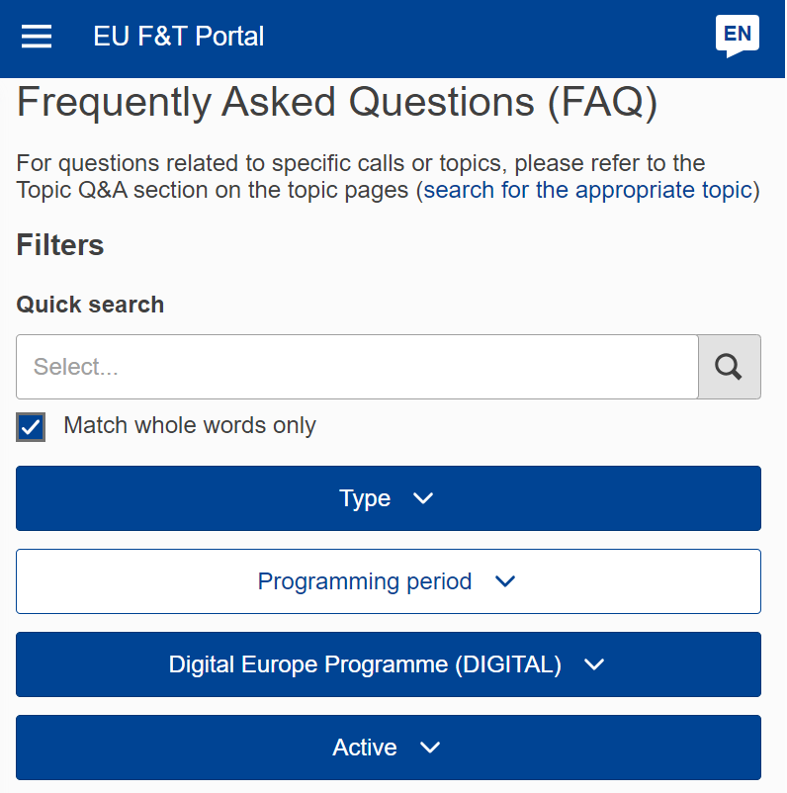
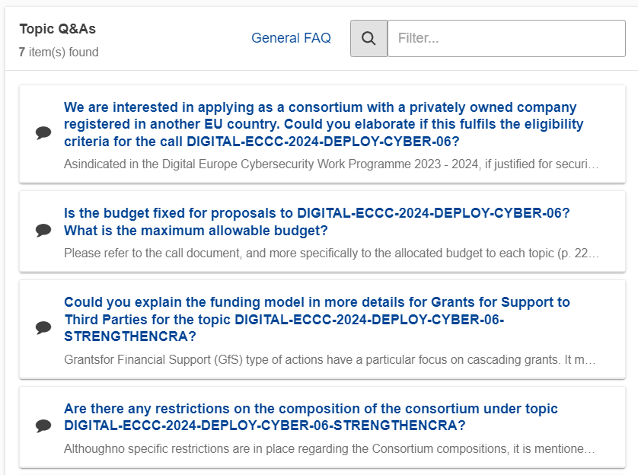
Questions?
Your NCC
Funding and Tender portal
General FAQ [link];
Topic Q&A [example link]

Slide 11
In summary
Proposals should be
Admissible Eligible Original
Eligible
Clear
Convincing
Complete
Aligned Clear Explained References
Maturity Added-value State-of-the-art Experience
Logic Interlinked Balanced Controllable Measurable Complete
Scale Impact Audience Impact
11

Slide 12
Keep in touch
Thank you!
ECCC Newsletter
ECCC LinkedIn
ECCC Twitter/X
ECCC Website
info@eccc.europa.eu
Europe digitally secured

